Slide 1


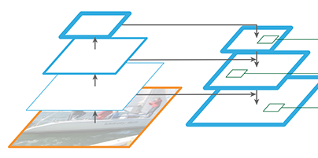
PPM
1/32
1/32
1/16
Fused Feature Map
1/16
Prediction
1/8
1/8
1/4
1/4

Slide 2
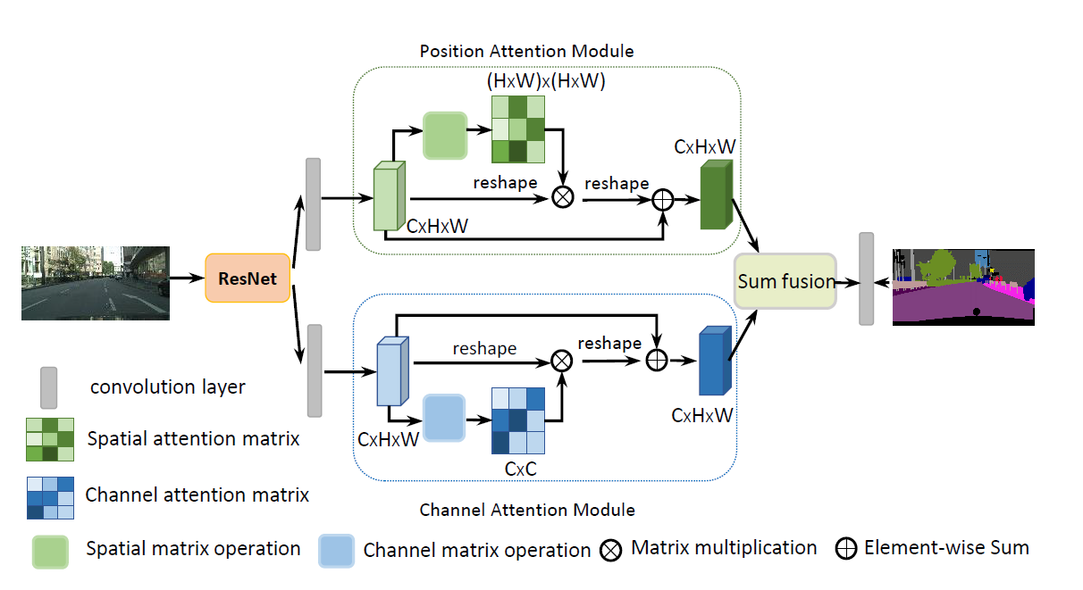
S
X

